Slide 1
Software Engineering
Lesson 3 – Software Process Models

Slide 2

Last Time we covered…
What is Software Engineering?
Why is it important?
Costs of Software Engineering
Areas and Scope of Software Engineering
4 Ps of Software Engineering

Slide 3
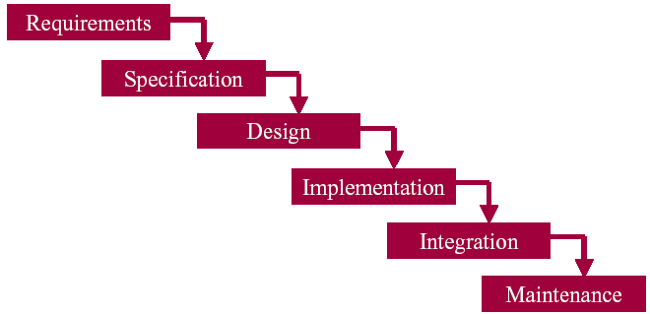
Today’s Lesson Content
Stages of the Software Process
The Waterfall Model and tasks carried out on each stage
Planning and Feasibility study
Analysis
Design
Development (Coding)
Testing
Operation & Maintenance
Deliverables at each stage of the Model

Slide 4
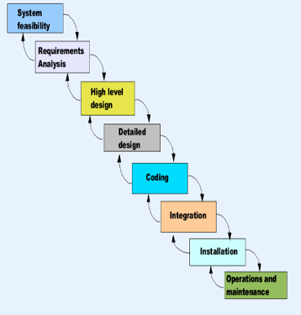
Software Process Model...
What is it?
The splitting of software development work into distinct phases containing activities with the intent of better planning and management.
Who decides on the stages?
Managers choose an appropriate process for a specific type of projects and follow it.
Why do we use process models?
It provides clarity and makes control and management easier to perform
This helps to build a reliable, good quality product
What are the steps?
These depend on the project and the model you chose for it
Personal webpage vs. Life support system

Slide 5
Software Process Model...
Somerville defines 4 main stages:
Software Specification
The functionality of the software and constraints on its operation must be defined (Planning and Analysis)
Software Development
The software to meet the specification must be produced
(Design and Programming)
Software Validation
The software must be validated to ensure that it does what the customer wants (Testing)
Software Evolution
The software must evolve to meet customer changing needs over time (Operation and Maintenance)

Slide 6
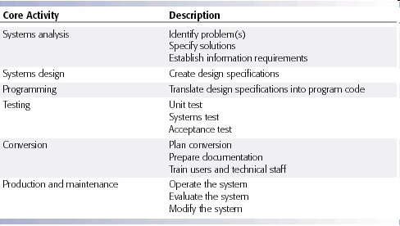
Software Process Core Activities

Slide 7
The Classic Software Process Model...
The Waterfall Model is the 1st Process Model (1956)
The Traditional Process Model consists of 6 phases:
Planning and Feasibility study
Analysis
Design
Development (Coding)
Testing
Operation & Maintenance
It is a Linear (Sequential) Model
1Every stage is successfully finished before the next starts
Output of one stage constitutes the input of the next stage
Extremely hard to return back to fix problems on previous stages
Notes:
Model is :
The oldest and easiest to understand
Stages are similar to other engineering disciplines
(in fact it has it’s origins in building and construction – you can easily apply the same steps to building a house)
The first known presentation describing the use of structured development using phases similar to those in the Waterfall Model in software engineering was held on the 29th June 1956.
This presentation, about the development of software for SAGE, was held by Herbert D. Benington at Symposium on advanced programming methods for digital computers.

Slide 8

Phases of Software Process in detail
Systems Planning and Selection
Identification of need or opportunity
Determine scope and objectives of a system
Why is a new system being considered?
What purpose does it aim to fulfil?
Conduct a stakeholders analysis
Feasibility Study
Explores possible forms that a system may take and determines which is the most appropriate. Involves taking into consideration various factors:
Financial, Technical, Social, Ethical, Organisational, Legal
Project Planning (work plan, schedule, staff)
Once a decision is taken based on the feasibility study, we now must:
Define goals and products of the development effort
Identify the tasks and resources needed
Sketch a schedule and a budget
Set up a project management structure
8

Slide 9

Phases of Software Process in detail
Systems Analysis (what? who? when? where the system will be?)
Study of current procedures and information systems
Investigation
defining the problem
identifying its causes
Determine requirements
who needs what information, where, when, and how
Generate alternative solutions
Recommend best alternative
9

Slide 10
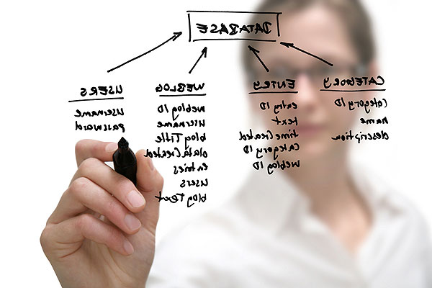
Phases of Software Process in detail
System Design (how will the system work?)
The overall plan or model that shows how the system will meet its information requirements
This is like a blueprint of a building or a house before it is built – it contains all the specifications that give the building shape and form
Similarly, the design will tell us how the system will be interacting, the modules it has, how information is passed on, etc.
Contains:
Architecture Design (Network, HW, SW Selection)
Software Program Design
Database Design
User Interface Design
10

Slide 11
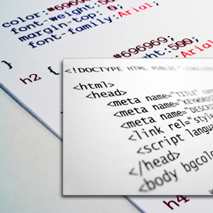
Phases of Software Process in detail
Development
Hardware and software installation
Programming
System specifications that were prepared during the design stage are translated into software program code
Some software engineering techniques like UML allow you to generate code automatically
However, generally once the design is specified, the programming is outsourced, or an off-the-shelf package is bought
User Training
Documentation
11

Slide 12

Phases of Software Process in detail
Testing
Determines whether the system produced is actually what is needed
Does it provide the right information?
Does it work well under normal operational conditions?
Does it work well under stressful conditions? And at what point does the system break down?
Types
Functional Testing
Nonfunctional Testing
Performance
Reliability
Levels
Unit Testing
Integration Testing
System Testing
User Acceptance Testing
12

Slide 13
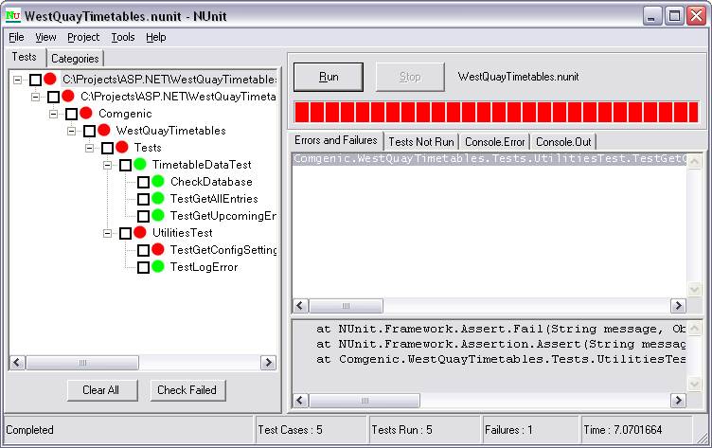
Unit Testing
Testing each module separately
Look at it as a divide-and-conquer approach to testing
Rather than testing a system as a whole, we test units/modules individually to ensure that it is doing what was originally specified in the design process

Slide 14
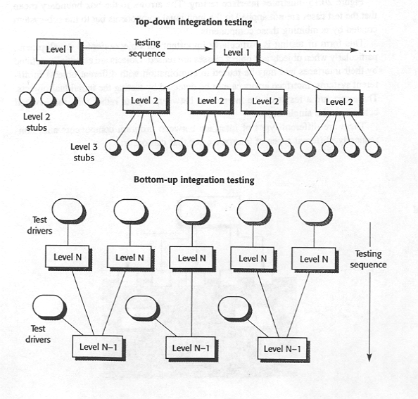
Integration Testing
Integration Testing – tests interfaces between components, interactions to different parts of a system, such as the operating system, file system, hardware or interfaces between systems
Goal: To expose faults in the interfaces and in interactions between integrated components
Scope: may include testing all interfaces, data exchange and variable passing between components
Typical Test Techniques: White Box, Top-down, bottom-up integration
Test Tools: Stubs , drivers and simulators may be used, Debuggers

Slide 15
Systems Testing
Tests the functions of the system as a whole
System testing may include tests based on:
risks
requirements specifications,
business processes,
use cases,
other high level descriptions of system behavior;
Also looks at non-functional factors such as:
Performance time
Peak loads
Recovery and restart capabilities

Slide 16

Acceptance Testing
A final certification that the system is ready to be used
These are carried out by users and reviewed by management, since only these people can actually confirm if this is the system they originally required to be developed
Once the system is accepted, it can be installed throughout the organisation

Slide 17
Operation and Maintenance
A software system is often in service for years or decades. During this time the system and its environment is often corrected, changed or extended.
Maintenance is done on an current operational system, and is triggered by modifications, migration, or retirement of the software or system, e.g:
planned enhancement changes (e.g. release-based),
corrective and emergency changes, and
changes of environment, such as planned operating system or database upgrades, or patches to newly exposed or discovered vulnerabilities of the operating system.
migration (e.g. from one platform to another) should include operational tests of the new environment, as well as of the changed software.
17

Slide 18
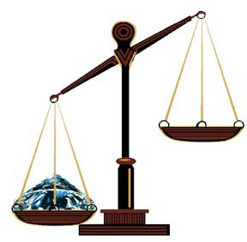
Waterfall Model: Advantages and Drawbacks
Advantages
Remains important and widely used due to simplicity
Enforced disciplined, planned and manageable approach.
Documentation
Drawbacks
Can all the requirements be specified in advance? (business uncertainty)
Requirements grow and change
Leads to a somewhat bureaucratic style of work.

Slide 19
The Evolution of the Waterfall Model
The Waterfall Model served it’s purpose for many years but :
It’s Linear Nature was problematic
In reality often we need to go back to earlier stages and revise the work that was made; especially because we cannot know everything from the very start!
It was highly Document Oriented
This meant that more emphasis was being put into the paper work then on the actual system deliverable which, after all, is what mattered most to the client.

Slide 20
The Evolution of the Waterfall Model
Winston W. Royce presented this model as an example of a flawed, non-working model in article entitled “Managing the Development of Larger Software Systems” with this famous quote :
“In my experience, the simpler method has never worked on large software development efforts…” (1970s)
Royce’s adaptation of the Waterfall Model is the one that was most successfully applied to software development, it would take well over two decades for another breed of models to slowly displace the Waterfall as the dominant software development process.

Slide 21
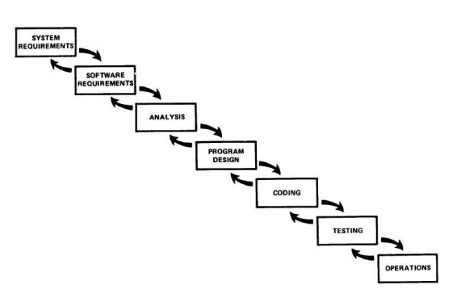
Royce Modification
Original Waterfall Model | Royce Modification
Consists of sequential, non-overlapping phases, where a phase cannot begin until the previous phase is already completed. At the end of every phase, there is a gate where a decision is made to allow the project to move forward or not. The product is only finished at the end of the last phase. Once the project is done, the product/service enters into a maintenance phase. The testing phase, which will uncover any issues with requirements, design flaws and bugs is carried out at the very end of the life cycle. | proposed an iterative and incremental approach and advocated that projects should pass through each phase at least twice. The idea was that the second pass of each phase would help bring to light flaws in the phase in which they originated; thus fixing such flaws would be easier than if these were discovered in later phases!

Slide 22
Model Phases and Their Outcomes…
22
What are the outcomes?
Software, Documentation, Data
Stage | Documents
Selection and Planning | Problem Statement Project Plan Quality Assurance Plan Feasibility Study Risk Analysis
Analysis | Requirements Specification Project Plan (updated) Logical UML Model Behavioural UML Model
Design | DB Specification Program specification Architecture Specification UI Specification Testing Plan Project Plan (updated)
Coding | Source documentation Installation guide Users Manual Training Plan Test Cases
Testing | Test Cases (updated) Test Report
Maintenance | Training Material Bug Reports, Service Requests

Slide 23
Variety of Software Processes
Many different Software Process Models exist today.
Most common are:
Classic Life Cycle – Waterfall (for small projects)
Evolutionary Development Approach
Prototyping/Incremental/Spiral Model
Others in use are:
Prince 2 (used for EU Government Projects)
SSADM
RAD
All Process Models are Different!
All have traits that make them ideal for certain situations
Some are rigid and require detailed planning ahead, strict control, change management (heavy weight) while others are more flexible and adaptive (lightweight).
All of these are idealized views!
In reality the project doesn’t follow one process precisely

Slide 24

Process Model Selection
How do we select the best process model?
The most suitable model and details of phases vary based on:
Type of project
(Scientific, Embedded, Business, etc.)
Characteristics of the project
(Large vs. Small, Complex vs. Simple)
Common Sense judgment
Experience and Size of the project team
The kind of people involved!

Slide 25

What is Stakeholders Analysis?
Software Projects are not just about the final product! They are also about the people that will create this product and the people that this product will help!
People can make or break a project, therefore Stakeholder Analysis is Important!
This aims to identify the groups of people that the project will effect, and how they are effected (positively or negatively)
Users
Managers
Customers
Analysts
Developers
Consultants
Government
Stakeholder Analysis involves discovering :
The views that these groups have on the current system
The perception of these groups of the future system
Propose possible strategies to reduce negative impact, and maximise positive impact

Slide 26
Group Work
Split into groups of 5
Do a 15 min PPT presentation on one the following process models:
Prince 2 Model
Spiral Model
Incremental Model
Iterative Model
Evolutionary Model
Rapid Application Development
In your presentation Mention
A Brief History of the Model (when was it introduced, by who and why)
A Brief Overview of the SDLC Phases for this Model (include diagram)
Main Advantages of the Model
Main Disadvantages of the Model
Most Suitable Scenarios for Applying the Model

Slide 27

End of Lesson 3
Any questions?

